Slide 1


AYUCARE
Problem statement: Integrated common services to common people

Slide 2



Motivation
In today’s fast paced world, accessing the right healthcare from vast set of innumerable service providers is so time consuming.
Every Health service providers host their own websites ,leading to the common people to visit each and every website and then check for their Availability, Timings, Contact and Address.
So, here I have created a single, easy to use portal for the common people to access all the available healthcare services in an integrated manner, so that the people save time and get the Crisp information about the service they want to get.

Slide 3
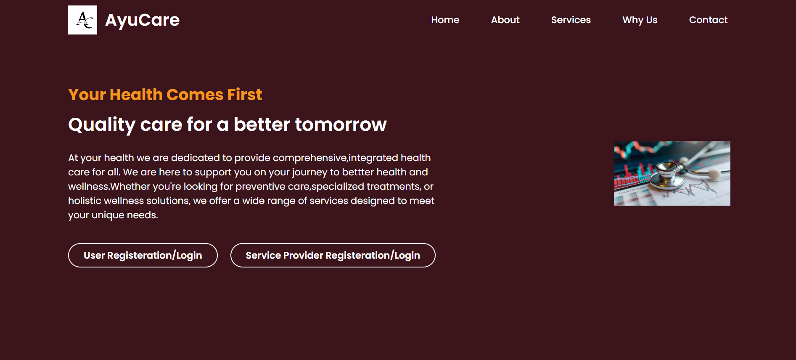
The Solution
Introducing a web application, named AyuCare ,which the user can access through any digital device may laptop, mobile or tablets.
A 24/7 Access: Use the platform Anytime, anywhere ensuring that healthcare is always within reach , even in emergencies.
Stay on top of your health with regular screenings, check-ups and wellness tips.
Effectively manage chronic conditions with integrated support and resources.
We strive to bridge the gap between patients and healthcare providers by leveraging technology to create a seamless and user-friendly experience.

Slide 4
Mission
The mission is to transform healthcare by providing a comprehensive, accessible and personalized platform for all. It is the strive to empower individuals to take control of their health by connecting them with healthcare providers and offering them a seamless experience leveraging convenience and efficiency.
The Mission and Vision
“Empowering health, Connecting Care.”
Vision
The vision is that everyone has easy access to emergency health services available, regardless of their location and circumstances. By continually advancing our platform and expand our service offerings, this project envisions becoming the leading solution for integrated health services., promoting overall well being of everyone.

Slide 5
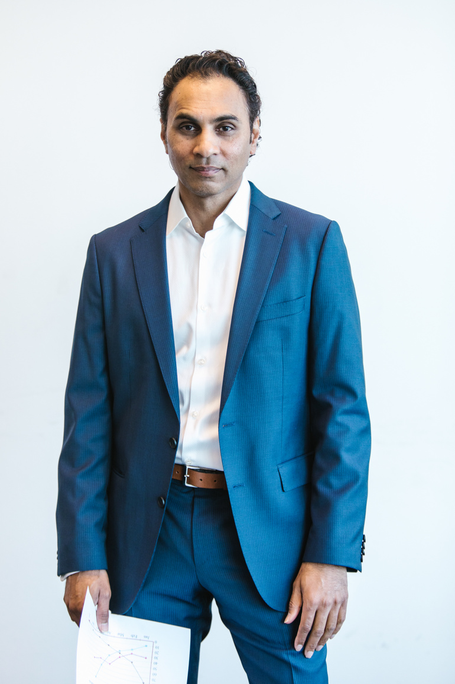



Hospital services
Lab testing services
Features Offered
Nearby Pharmacies Open
One platform, endless health solutions.
Health insurances
Clinic Services
Easy registration and login for users and service providers

Slide 6
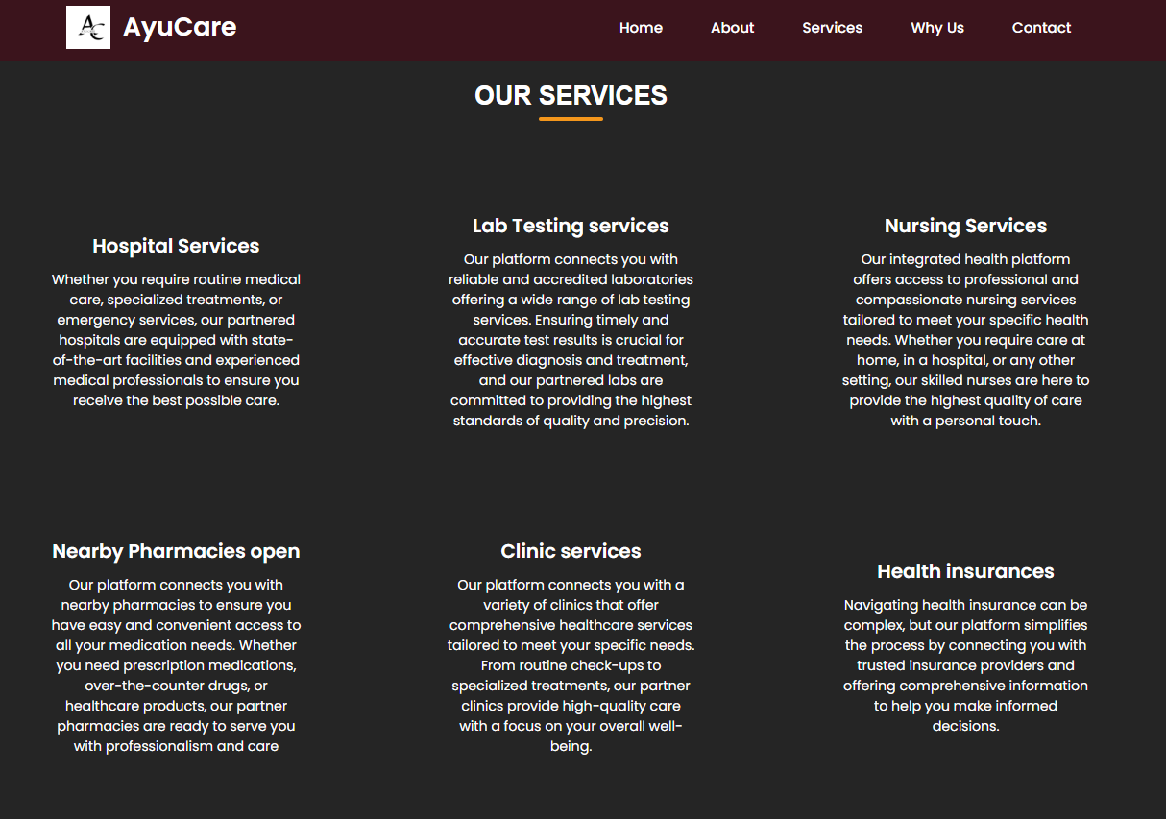
Take a peek at website
for clear view of the features provided.

Slide 7







Process flow
for a service provider
Register your service
Fill up all the required details as asked in the form.
Enter your Area
Look at a step by step instruction provided for you to use our application.
if you are a service provider.
Enter your area so that the users can reach to you.
Enter your contact details
Enter your contact details.

Slide 8
Process flow
for a user
Register yourself
Fill up all the required details as asked in the
form like email id.
Look at a step by step instruction provided for you to use our application.
if you are a user.
Enter your Area
Enter your area so that the you may get the nearest location health services.
Enter your contact details
Enter your contact details.

Slide 9
Web Browser
HTML/CSS/JS
Architecture diagram
Web server
Handles HTTP requests
It is a family of related standards that together describe a unified approach and common architecture to constructing interoperable simulation systems
PHP server
Processes logic, interacts with database
Security layer
User/Service provider’s password encryption
SQL database
User’s data and services data
Networking layer
Internet,Internal
Application layer

Slide 10





Technologies Used
Tech knowledge incorporated in this project :
205
HTML is used here for structuring contents
of the website.
CSS is used here for styling the website for better UI/UX experience.
Javascript is used here for adding interactivity to the web page.
PHP is leveraged here for collecting, encrypting the data and performing operations on database.
SQL is used here for storing, retrieving and manipulating data in the database.

Slide 11
The project is made by
Anushka Daflapurkar,
a 2nd year student at SMV College of Engineering, Raichur.
This project of Integrated common services to common people is made in individual manner. The source and motivation to build this project was the key factor of lack of comprehensive information unavailable to the common people in healthcare section.
About
me
for knowing the participant into building this project.

Slide 12
Conclusion :
AYUCARE
The main aim of the project is to bridge the gap between the service providers and the users through a virtual seamless connection profiting both the parties.
Using all the robust and modern technologies like HTML, CSS, JS for frontend and PHP, SQL for Backend, this GUI application is made for powerful, user-friendly and secure integrated health service platform.
The delivery of comprehensive services all in one plus with just a click away.
This application uses secured and protected credential data, caring the privacy of all the users .
Personalized care available whether you need lab services, hospital services or pharmacies! Everything is sorted in a right manner for your better user experience.

